Slide 1

Teaminator 3 GT Bootcamp Project 3 Final Presentation
April 2022

Slide 2
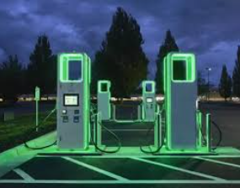
Discussion Agenda
Electric Vehicle Charging
Overview of our Project
Explanation of our Approach
Show our Results

Slide 3

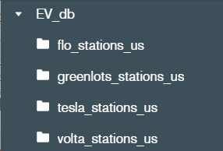
Overview
Sales of Electric Vehicles are increasing each year and the demand for EV Charging Stations is increasing at a similar or higher rate. We create a map of EV Charging stations throughout the US that would allow owners of electric vehicles to plan a trip
Approach
Pulled data from National Renewable Energy Laboratory API for four major Electric Vehicle Charging Stations (Over 3,000 stations)
Tesla
Greenlots
FLO
Volta
Stored the data for each Vehicle Charging company in separate collections in a Mongo Database
Created a Flask Server that accessed the Mongo Database to pull the data to create a Website that will allow users to see all the EV Charging stations for these providers along with key information about each.
Users can see all EV Charging stations or use check boxes to select a specific provider

Slide 4
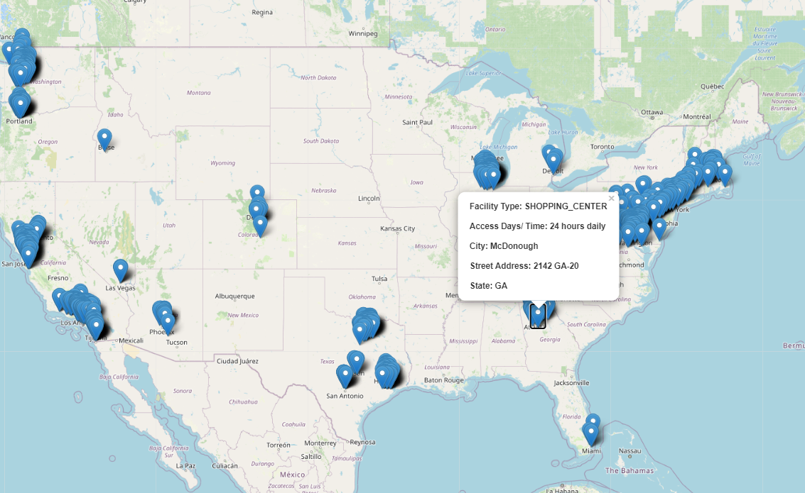

NREL API
Mongo DB
Python
4 EV Providers
> 4000 Stations
Project Summary
EV Charging Station Map
(Leaflet, HTML, CSS, JavaScript)
FLASK Server
(Python)

Slide 5
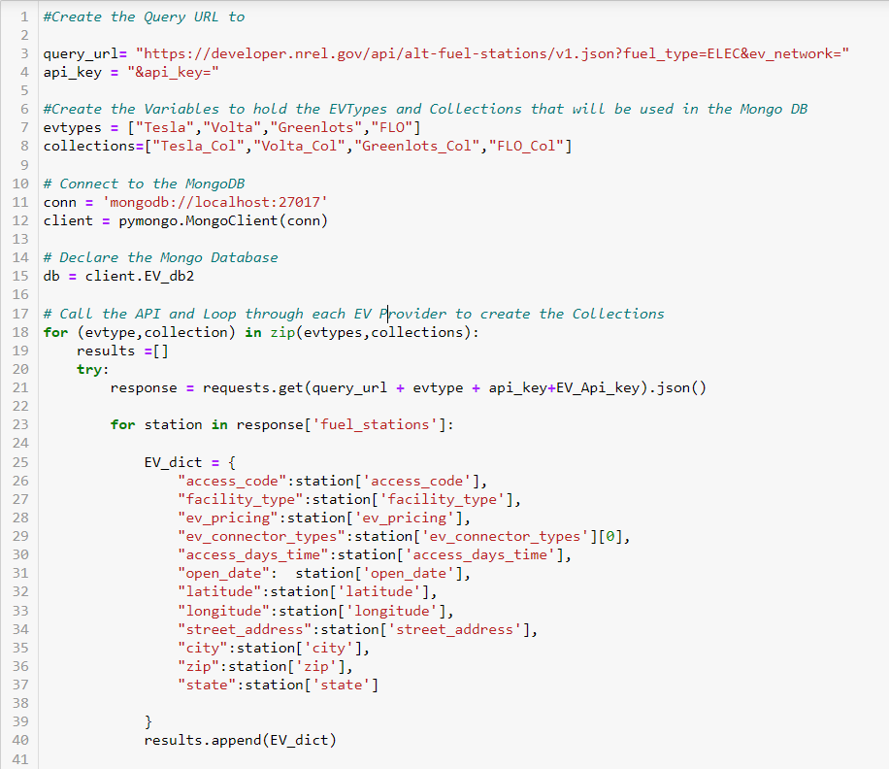
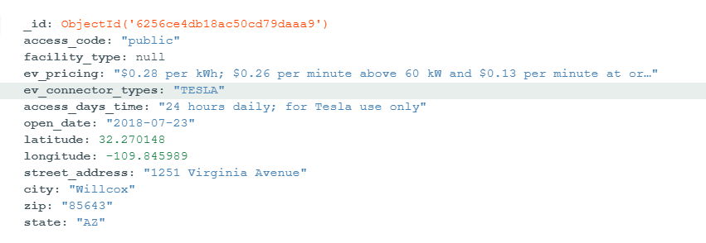
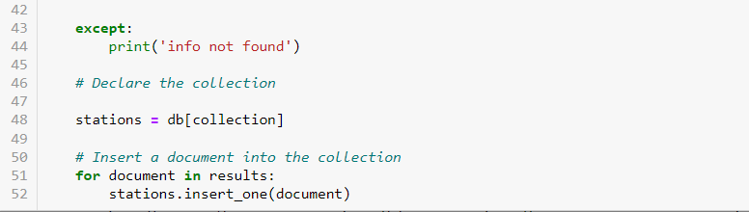
NREL API Call
Initially pulled the information for each provider in separate calls and added them to the Mongo DB.
Refactored the code to create a For Loop using ZIP that looped through each provider and
Refactored Code
Was able to reduce the initial code that had over 200 lines down to just over 50 lines that used a ZIP function to loop through each provider and create a collection for each
Document / Object Example

Slide 6
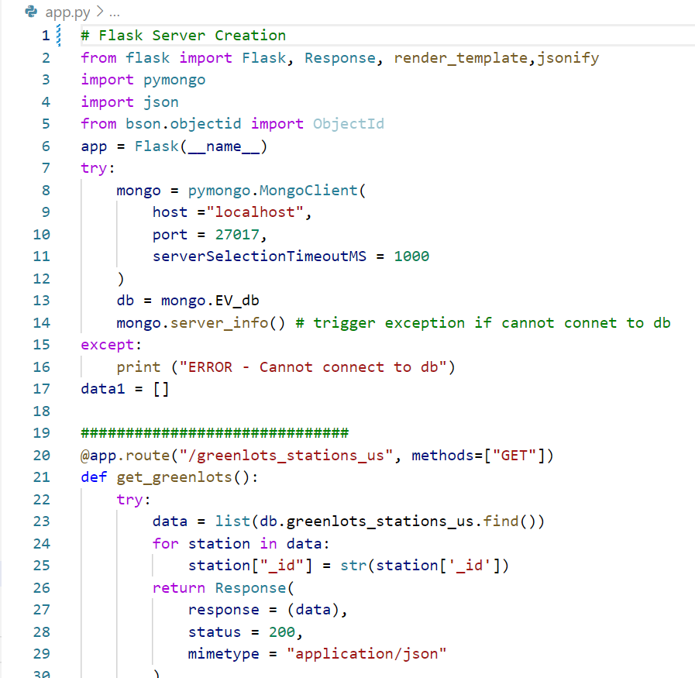

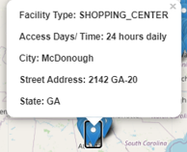
Flask Server
Created 4 Routes that allow users to select the EV Providers that they want to view.
Tesla
Volta
Greenlots
FLO
Provided key information on each station when selected
Facility Type
Access Days/Time
City
Street
State

Slide 7
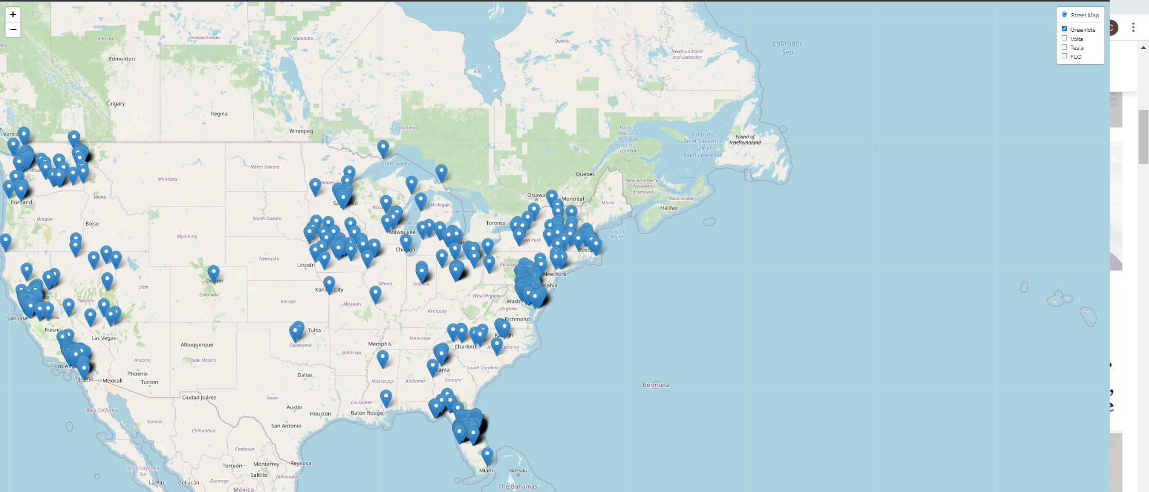
EV Charging Stations

